Slide 1



22ITT31 - Design and Analysis of Algorithms Presorting-Based Reconciliation of Orders and Payments in Robotic Warehousing Systems
Presenting by:

Slide 2
Problem Description
Some items were shippedbut might not have been paid for due to a system error.
Two lists are available — one with shipped order IDs and one with paid order IDs..
Identify which shipped items were not paid for and if any payments were made for items not shipped.
Use a presorting-based algorithm to compare both lists and find mismatches quickly.

Slide 3
Objectives
Searching large data with linear methods is slow.
Faster and efficient search methods are needed.
Decrease and Conquer reduces the problem size step-by-step.
It is used in fast algorithms like Binary Search.
3

Slide 4
Steps of Decrease and Conquer Search Algorithm:
Initialize variables:
Set low = 0 (start index)
Set high = n - 1 (end index)
Repeat while low <= high: mid = (low + high) // 2
Compare the middle element (arr[mid]) with the target:
If arr[mid] == target: Return mid (target found).
If arr[mid] < target: Set low = mid + 1 (search right half).
If arr[mid] > target: Set high = mid - 1 (search left half).
Termination condition:
If low > high, return -1
4

Slide 5
System Study
Input
orders list: Order IDs of shipped items
payments list: Order IDs of paid items
Process
Sort both orders and payments
Use two-pointer comparison technique
Output
List of unpaid orders
List of extra payments
5

Slide 6
Requirement Specification
Input
A list of order IDs that were shipped.
A list of order IDs for which payments were received..
Output:
List of order IDs that were shipped but not paid for
List of payment IDs received for items not shipped.
Time Complexity:
Sorting orders list – O(n log n)
Sorting payments list – O(m log m)
Comparing both lists – O(n + m)
Overall Time Complexity – O(n log n + m log m)

Slide 7
Pseudo Code:
Function FindUnmatchedOrdersAndPayments(orders, payments):
Sort orders
Sort payments
Initialize unpaid_orders as empty list
Initialize extra_payments as empty list
Set i = 0, j = 0
While i < length of orders AND j < length of payments:
If orders[i] == payments[j]:
Increment i and j

Slide 8
Else If orders[i] < payments[j]:
Add orders[i] to unpaid_orders
Increment i
Else:
Add payments[j] to extra_payments
Increment j
While i < length of orders:
Add orders[i] to unpaid_orders
Increment i
While j < length of payments:
Add payments[j] to extra_payments
Increment j
Return unpaid_orders, extra_payments

Slide 9
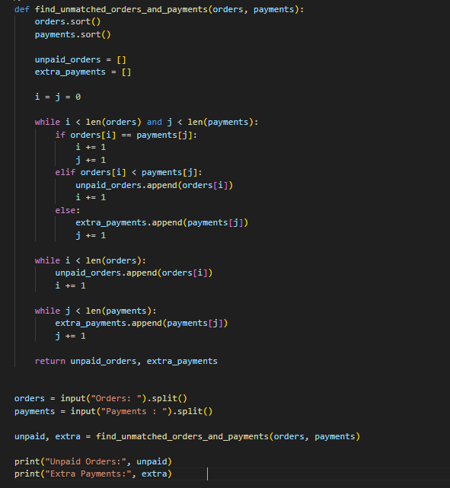
CODE

Slide 10
Thank you!

